Slide 1
FELABAN Presentation
20th November 2014

Slide 2
Agenda
Dodd Frank OTCD and EMIR regulation
Why are CCP’s mandated?
How did one large CCP prove resilient in the Financial and Sovereign debt crisis?
Strategic direction of financial markets
Notes:
Good afternoon every one, thank you for the invitation to speak to you all today. I shall try to make the presentation as interesting as possible given that I have been asked to talk about regulation, this is not easy. So I will cover the following topics, but I will spend a good proportion of my time talking about CCP default’s, simply because I feel this gives the best justification for the imposition, by the G20,of the Global CCP mandate.

Slide 3
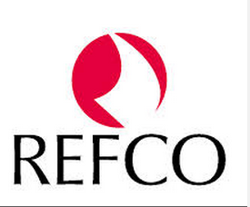
Biography
Business Development, Treasury & Clearing: Calypso Technology 2014
Group Treasurer: LCH.Clearnet Group 2000-2013
European Treasurer: Refco Overseas 1999-2000
Treasurer: Daiwa Securities, London 1997-1999
Treasurer: Credit Lyonnais 1992-1997
Director, Money Market: Midland Bank/HSBC
Notes:
Hopefully my experience gives me credibility to talk agenda that I have described. Those of you who are experts in financial crises, will notice not only that my time at Credit Lyonnais, coincided with a considerable crisis at the bank and a partial bail out by the French government. But also I worked for a Japanese investment bank during the Japanese credit crunch in 1998. This probably equipped me to deal with the 2008 crisis and 2011 European debt crisis, but more of that later.

Slide 4
Formidable Regulatory Change
IFRS / IAS
32, 9, 19
Daily Maximum Intraday
Liquidity Usage
CFTC Collateral
Dispute Reporting
Collateral Dispute
Reporting (EU)
MiFID
EU OTC Derivatives
Regulation
EMIR Portfolio Recon.
EMIR Reporting IRD/CRD
FSB Shadow Banking
Basel II
Basel II Market Risk
Amendment (MRA)
EMIR Mandatory Clearing
EU Financial
Transaction Tax
SIFI & G-SIB capital requirements
2007
2008
2009
2010
2011
2012
2013
2014
2015
2016
2017
2018
2019
Sub-Prime
Crisis
Financial
Crisis
Dodd-Frank Act
IM on
Cleared OTC
IM on
Bilateral OTC
JSOX
Basel II Pillar
Enhancements
US Market Risk Rule
Mandatory
CVA
LCR (EU)
NSFR (EU)
Wrong
Way Risk
LCR (US)
NSFR (US)
Basel III
G-SIB – Global Systemically Important Bank
IM – Initial Margin
LAB – Liquid Asset Buffer
LCR – Liquidity Coverage Ratio
NSFR – Net Stable Funding Ratio
SIFI – Systemically Important Financial Institution
Capital Quality
Liquidity Standards
Leverage Ratio
Risk Coverage
Counter-Cyclical
Measures
Notes:
Here is a slide that seeks to sum up the thrust of Global regulation. But to give you my personal view there are 5 major threads of regulation,4 are ratios and the other is a relatively newly announced measure.
Solvency ratio: seeks to limit assets weighted by their riskiness, relative to equity
Leverage ratio: seeks to limit assets relative to a broad equity measure, but without risk weighting
Net stable funding ratio: seeks to ensure illiquid assets have long term funding
Liquidity Coverage ratio: Ensures banks have 30 days of liquidity
Total loss-absorbing capacity: Limits risk weighted assets relative to equity and certain bonds
Incidentally the BoE makes UK CCPs (big one’s at least ) obey the LCR already.

Slide 5
Dodd Frank and EMIR impact on OTC derivative markets
Differing legislation but aimed at reducing risk and increasing transparency in OTC derivatives
5 broad thrusts of the regulation affecting OTCD,4 are substantial
Execution
Clearing via CCP’s
Uncleared trades VM and IM
Trade repositories and reporting
Conduct, portfolio,anaylsis

Slide 6
Dodd Frank OTCD main points
‘Dodd-Frank can be thought of as a reaction against the worst excesses of the financial sector at the height of the housing bubble, and as a line of defence against future financial panics’.
Mainly seeks to regulate OTCD,cleared and uncleared
Heavily influenced by AIG bailout, not just banking sector
Leans heavily on ETD regs, extended to OTCD

Slide 7
EMIR main points
Covers all derivative transactions - Equity, interest rate, currency, commodity, credit, “other” - Includes OTC and exchange traded derivatives - - Includes retail derivatives such as spreadbets
No threshold below which transactions are not reportable
Includes modifications: -Novations -Terminations and partial terminations

Slide 8
Major differences
EMIR does not require SEF’s as yet
DF defines market actors, eg Swap dealers and Swap participants
EMIR requires multiple client segregation models
Extraterritoriality
EMIR differs from Dodd Frank by including ETDs - No exemptions for “non-EEA derivatives” - Trading venue and underlying assets are irrelevant
EMIR has no exemption for index or basket products
EMIR includes retail derivatives eg spreadbets.
EMIR much more onerous for CCP’s to comply

Slide 9
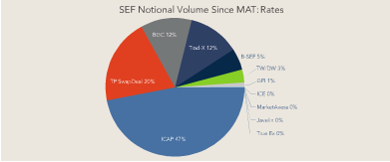
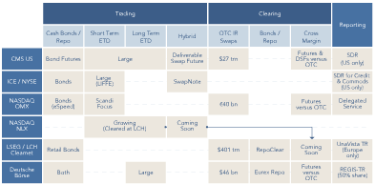
Progress to date

Slide 10
Why were CCPs mandated?
Appeared to be very resilient during financial turmoil
Most Bank participants treated CCP’s and FMI’s as safe haven
Non-banks seriously undermined by uncleared OTCD exposure
Trading in Cleared markets(ETD+OTC) seemingly unaffected in 2008
Many uncleared markets traded by appointment
Highly liquid markets spot+ forward FX, much more dislocated than widely accepted
No CCP resorted to DFF or Central bank liquidity assistance, in resolution of defaults.

Slide 11
Global Legislation for Clearing G20
In its Financial Stability Report, October 2008, the Bank of England noted that the ability of LCH.Clearnet to close out the positions without using up all available margin, “illustrates the ability of a clearing house to protect market participants from bilateral counterparty risk, even in the event of default of a major participant.”
Notes:
Here is a statement from the Bank of England,this was an early statement of intent. Very interesting to note how little contact LCH had with BoE in 2008,this placed them on a steep learning curve.

Slide 12
CCP’s and the management of defaults
Notes:
At this point, here is a blatant advert for the CCP’s to whom my firm provides clearing technology. We are extremely happy to provide technology for 2 CCP clients in Latin America.

Slide 13
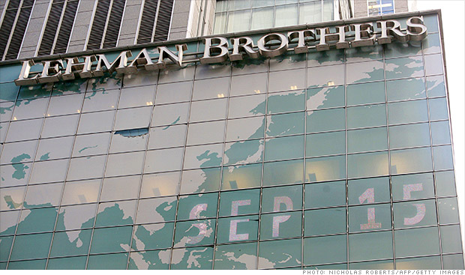
At 07:30 on September 15 2008, the London Stock Exchange suspended Lehman Brothers from trading, and at 09:15 LCH.Clearnet declared Lehman Brothers to be in Default.
Notes:
I do not intend to add further to the global analysis to the reasons behind the LEH default, suffice it to say that confidence in the bank evaporated and even a moderately leveraged Bank will not survive in these circumstances. It is impossible to describe LEH business as even ‘moderately leveraged’. As the GT of LCH we already significantly reduced our direct exposures following a bi-lateral meeting, where they came in to explain why they had raised new equity capital that they did not need and offered an increase on haircuts on our secured lending to them. In my opinion when bank comes in the GT to explain that they are a great credit and there is nothing to worry about, it’s often time to make some tough decisions. Of course LEH continued to be a clearing member in good standing, until the Monday morning, all margins IM and VM were paid promptly so clearing business continued as normal until Monday.
CCP’s have three major objectives after a default – to eliminate the risk acquired from the defaulting members position within the defaulters margins
-to facilitate the movement of client positions where possible
- to continue offering clearing services to non-clearing members
Post the events of 15th Sep it was time to find out if CCP’s were ready to achieve these objectives.

Slide 14
Assets Classes and Margin Held by Lehman Brothers
Notional $10 Trillion across all asset classes
Margin +DFF ~$1.6 Billion
Interest Rate Swaps
Fixed Income (Repo’s) in London & Paris
Cash Equities in London & Paris
Energy OTC and ETD on ICE
LME
LIFFE Financials and Equity Derivatives
$1.6 Billion Margin & DFF
$10 Trillion
All Asset Classes
Notes:
At this point, I would like to give you a flavour of the positions that LEH were carrying when they defaulted. Quite eye catching numbers I am sure you will agree. This is a very high level summary across LCH Ltd and SA. LCH is a multi asset class CCP ,the default meant LCH acquired positions in multiple markets. It is important to note that a CCP becomes pretty much an investment bank on default day, but are not generally staffed by ex-traders.
I will explore in some more detail the IRS and FI default, but as always there were some other significant risks not directly tied to the clearing default. I will explore one of these in some detail and that is the default of LEH as a Treasury counterparty. The asset classes which I won’t cover, because of time, were in some cases very large, and directional (eg long of energy) but also neutral (LEH was a huge equity trading house, but ran neutral risk) on a portfolio basis.
One statistic I will share with you is that we had clearing members who were five times larger than LEH at the time they defaulted. One can only imagine the impact of an even larger institution becoming insolvent on the global economy.

Slide 15
Other Significant Risks and Issues
Unprecedented size of default, no rehearsals
Lehman was Treasury counterparty to EUR 400 mio of secured (tri-party loans)
Main counterparty for US secured investments
Contagion, if no Bank is safe, how to invest $38B margin safely?
Collateral held X currency e.g. Bunds for all IRS
$6B of ICE margin held in escrow accounts
DR invoked 7 days into the default
Lehman 5x smaller than largest clearing member
Notes:
I have to say that even until Sunday the 14th Sep, I did not think that LEH would be allowed to default, there were rumours of bail-outs and rescues, we were in
reasonably close consultation with the UK regulators. But it was clear they were concentrating on the banking sector and a possible acquisition of LEH by BarCap.
It was not CCP best practice to rehearse default events and though LCH had defaults before, they were tiny and involved rogue traders (Baring+ Griffin trading) and therefore not systemic.
As I mentioned earlier, the reinvestment of member default fund, IM and VM had moved to a secured lending basis, but counterparties included LEH. Selection was entirely rating based and they were A- on day of default. This was an extra burden, but they were the smallest counterparty ,as we had unilaterally reduced outstandings with them.
LCH rules allow x-currency margining, FX market was far less liquid than widely recognized, especially in forward swaps. We had EUR 250m vs JPY T+3 trade only got done best order.
If the events engulfing the CCP were not enough the main power cable was accidentally severed, back up systems overloaded and DR was invoked half way through default.

Slide 16
Interest Rate Swap Default
Notional of $9 Trillion
66,000 Trades
5 Currencies
Default managed in Calypso Technology solution
Hedging completed 17/9
Portfolio’s auctioned within 5 days
Market participants highly motivated
Notes:
Characteristics of the IRS default were a large notional amount and a huge number of trades. LCH had formed an default management group, which is a rotating group of 6 senior rates traders from major banks. They arrived to manage the default on Monday morning.
Calypso was chosen in 2003 to be default management system. Deals were uploaded on a currency basis from clearing systems to Calypso, analytics were run, hedging strategy
agreed with DMG and executed by LCH staff. The neutralised portfolios and attendant hedges were auctioned to surviving members. As LCH is the only CCP to have dealt with a large OTC default this is general model in place globally. This sounds simple but was a huge logistical exercise for CCP’s and Banks , I personally doubted that senior swap dealers would turn up, but they did. There were legal agreements to encourage participation. Fire drills are now mandatory, regular and realistic. The relatively painless default was probably why regulators have been
so keen on cleared derivatives. However there is now a lot more clearing and clients are involved, this has added significantly to complexity because of porting and segregation models.

Slide 17
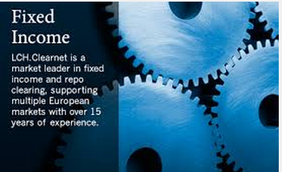
Fixed Income Repo Default
Short govvie positions hedged/liquidated internally
Significant EUR liquidity challenges
Govvie bond markets highly liquid
Dealers very helpful as high appetite for risk
Market infrastructure displayed high levels of coordination
Notes:
LEH was a large matched book repo trader, the default management was carried out by LCH staff. The only real issue was buying the govvie assets required to make deliveries in UK Gilt and Eurozone bond markets, when prices were rallying rapidly due to ‘flight to quality’. All payments for bonds delivered in, were made from LCH’s liquidity resources. These proved more than adequate, due to significant liquidity risk reductions in previous weeks and months. CCP’s were seen as a ‘safe haven’ and clearing members left large amounts of cash in LCH, even substituting their high grade non-cash collateral. Market infrastructure and market participants displayed unprecedented and seamless collaboration to unwind the trades but markets were highly liquid. This is not a given in certain circumstances and I will contrast this with subsequent events in Autumn 2011 later in the presentation.

Slide 18
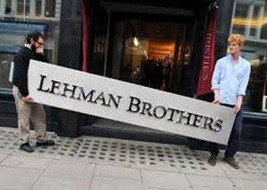
Treasury Counterparty Default
Challenging portfolio of assets acquired from Lehman including MBS
Non-govvie bond markets very illiquid
No fire sale required, because of good liquidity plan
Smallest counterparty, could have been much worse
Treasury/Collateral systems not fit for purpose
CCP Capital base was very small and only loss absorbing capital
Notes:
I mentioned earlier that the LCH Treasury had moved from recycling the margins it received from clearing members on an unsecured basis, to the repo markets from 2002 onwards. It was an obvious failure of risk management at a CCP to lend back to the clients cash it had called as margin to protect itself from risk. This does have at least one disadvantage, in that the large holders of collateral inventory are also your biggest clearing members. The collateral set that LCH would lend against was slightly wider than it would take for IM.
The result was a EUR 400mio loan with a 5% haircut was outstanding with LEH when they defaulted. Without collateral to support this loan, there would have been a very serious problem. LCH carried out a successful liquidation but some of the assets particularly AAA MBS proved very difficult to sell, because of underappreciated correlation with LEH.
The problems in liquidating more exotic assets informs you of why there are very conservative sets of assets accepted as IM at most CCP’s. This risk is not as widely recognised as you would think,certain CCP’s for instance take Corporate Bonds, which could prove illiquid in default scenario’s.
CCP’s are now required to have rules for allocating investment losses, so as not to deplete their capital.
Most CCP’s in Europe raised capital to be EMIR compliant
We realised that we needed to invest in technology in our Treasury area front-to-back as we only acquired relatively few ISIN’s from LEH,but there was mostly manual trading, settlement and reconciliation.

Slide 19
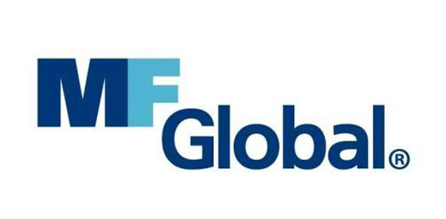
MF Global Ltd default in 2011
Default notice on Monday 31st October
Main exposure EUR 14B Fixed Income Repo
Main positions held in LCH.Clearnet SA
300 clients in ETD & Equities
LIFFE, LME, LSE, ICE, etc.
No Treasury counterparty exposure
Mainly US Treasury collateral
Large FX exposure
Notes:
To bring my observations a little more update, I will now briefly look at the MFG default. During the summer and autumn of 2011 there was a dramatic change in the perception of sovereign risks in the Eurozone periphery. With large European countries seeking bailouts and the ECB were active in support secondary bond markets in the Eurozone periphery. MFG had changed their business model from an execution broker to holding quite large Repo to maturity positions in Eurozone sovereigns. Rating agencies and equity analysts were aware of these positions, which led to downgrades and negative analysis. LCH was increasing margins on all FI positions, particularly concentrated positions in the Eurozone. MFG were called for large margins by various CCP’s,which they paid. It is understood this put MFG under severe liquidity stress.Having sought a trade buyer over the weekend 29^{th.} 30th,this proved impossible and the US company filed on the 31st October 2011. LCH served a default notice on Monday evening.
The exposure's and issues are summed up on this slide, superficially the size was much smaller and unsystemic but the concentration in illiquid markets was the stand out issue.

Slide 20
MF Global contrast to Lehman Brothers
Experienced CCP team, fire drills, lessons learnt
Liquidity in certain markets non-existent
Eurozone peripheral bond market highly dislocated
Position had been widely seen by other dealers
Low appetite to take on Risk among members
Customer transfers difficult
Private capital probably involved
Default on a Monday
Notes:
Many of the same staff were involved and much rehearsal and improvements to systems had taken place. But the main difference was the deterioration in liquidity conditions.
A similar arrangement as for IRS arrangements, now existed with a default management advisory group consisting of repo and cash bond traders called in. However this group said whilst market trading in UST, Gilts and core Eurozone governments was functional, tickets of EUR 50m were difficult in the periphery, we had a single, albeit short dated ISIN of EUR 2.3 Bn. This made for a very nervous 48 hours, especially as the news flow was talking about a Greek referendum and break up of the Eurozone.
As I was leading the default alongside the CRO and CEO in Paris, it was my responsibility to choose the Bank partners to participate in the auctions. We had to be convinced of their distribution, confidentiality and professionalism. We went for 4 banks in total, with good geographical diversification.
Auctions were held on Wednesday and Thursday and the major risks were closed on 3rd November within margins, though as ever there was a surprise when ECB cut rates in the middle of the final liquidation on 3^{rd.}
This was a very satisfactory result and it is noticeable that the highs in yield of certain Eurozone countries coincided with these events. A powerful rally started soon after these positions were cleared, which was probably correlated but not causal. Market liquidity has returned, but these events could be a source of worry for the future. European Markets Infrastructure regulation calls for CCP’s to model the default of the 2 largest clearing members, this will surely be extremely hard if it coincides with stress at the sovereign level, which seems likely.
It was much harder to move client positions as KYC regulations seem to make it problematic for non-defaulted clearing members to take client positions quickly.
The main lesson could be seen as very concentrated positions can be a problem even when a non-systemic Banks get into trouble.

Slide 21
LCH: AUM
$105bn
MF Global
Default
Sovereign
Debt Crisis
Lehman
Default
Liquidity
Crunch
$5bn
2001 2007 2008 2010 2011 2013
Treasury Management System
Front-to-Back
Liquidity
&
Collateral
+
+
+
+
15 yr old Banking System
Excel spreadsheets
Fax
Carrier Pigeon
Notes:
As a matter of interest, I thought I would show this chart of DFF and other margins under management at one of the large CCP’s.Not sure how many people realise how quickly and how large CCP’s have become. I understand this growth in assets is continuing today. Even as new CCP participants have joined OTC clearing, buyside clients have been mandated to clear, this has boosted the size of the opportunity for many CCP’s. The graph is not to scale, but is indicative of the rise in AUM at all CCP’s.
You may also notice that LCH has consolidated and automated its Treasury, Liquidity and collateral management onto Calypso technology.This was a 18 month project ,the final stages went live in May 2014. This should make the CCP even more robust, should markets deteriorate once again.

Slide 22
Conclusions
Large CCP’s have proved robust in the past
Sheer volume of business a challenge
Technology extremely helpful in stress
Risk concentration, liquidity and fire sale risk
Optimal ownership structure is unclear
Central Bank and CCP cooperation is imperative
Notes:
Here are my observations based on my experience.
CCP’s have proved to be a force for good in terms of stabilizing and providing continuity in cleared markets. But a lot more clearing is now taking place, CCP’s are modernizing and refining their processes and investing in systems. There are considerable risks due to the concentration of positions and the possibility that CCP’s may have to aggressively sell assets and positions to lower their risk. Most CCP’s are in private ownership, with shareholders looking for returns, this could be seen as a sub-optimal model as what incentivizes CCP’s to have invest heavily in their services and staff, there is a temptation to under invest to save money and boost shareholder returns.
Having dealt with defaults in LCH.Clearnet Ltd and SA, which differ in their access to central bank liquidity, I was pleased to read recently that the Bank of England is working on liquidity arrangements for domestic CCP’s. Close cooperation between central bank authorities and CCP’s is essential especially in stressful market conditions, it is my view that CCP’s must have formal access to central bank liquidity.
This concludes the first part of my presentation, if there are no questions I will move on, but I would encourage you to ask me about anything that is unclear at the end.

Slide 23
Strategic direction of Financial market participants
Calypso services 200+ clients, including Tier 1,2 and 3 Banks,9 major CCP’s, Central banks and buyside.
Strong position in Calypso business development to discuss global trends
Three broad areas:-
Consolidation of system’s
Trade automation
Demand for utilities.

Slide 24
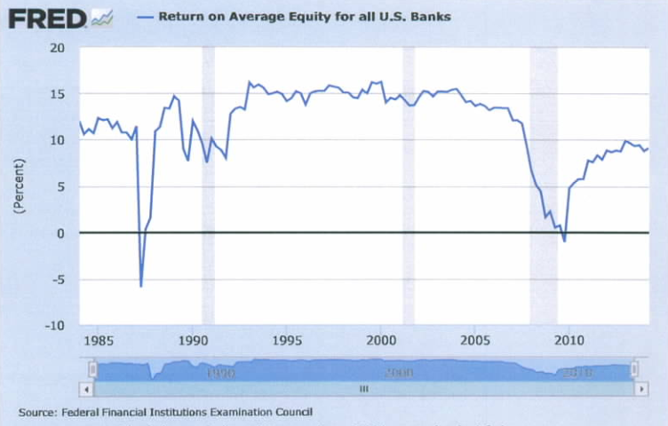
Return on Equity – US Banks

Slide 25
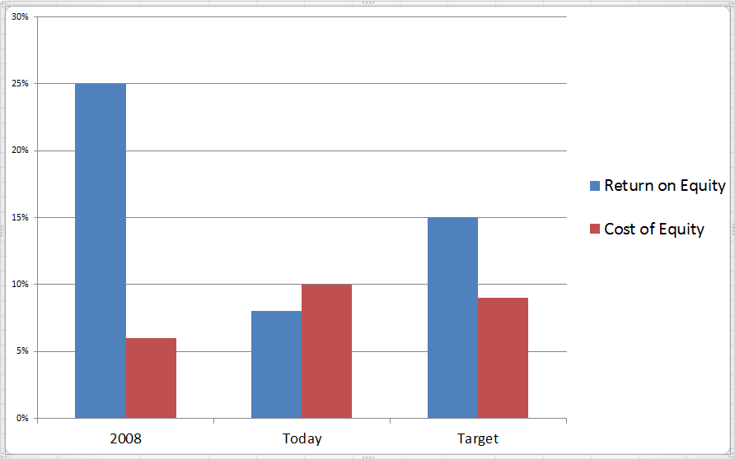
Return on Equity

Slide 26
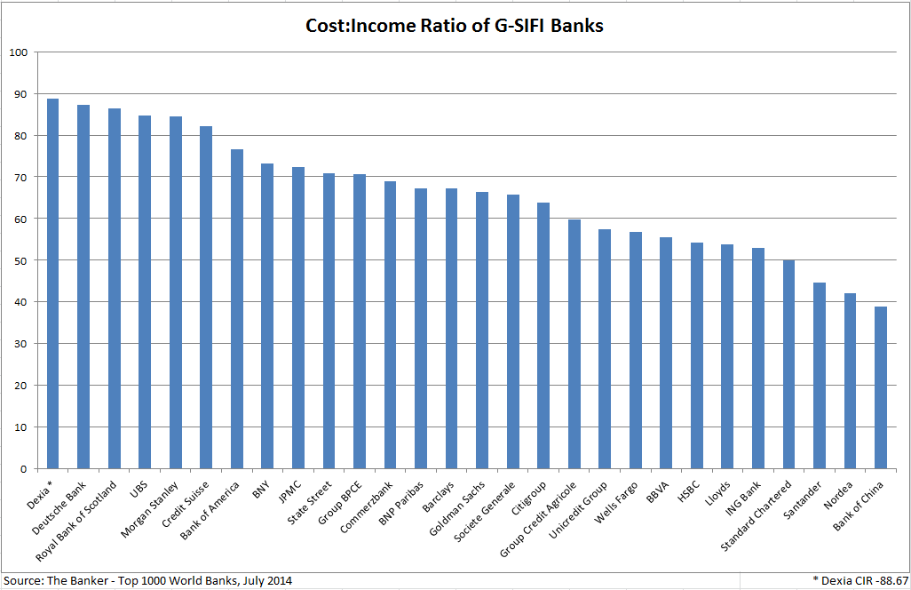
Cost : Income Ratio

Slide 27
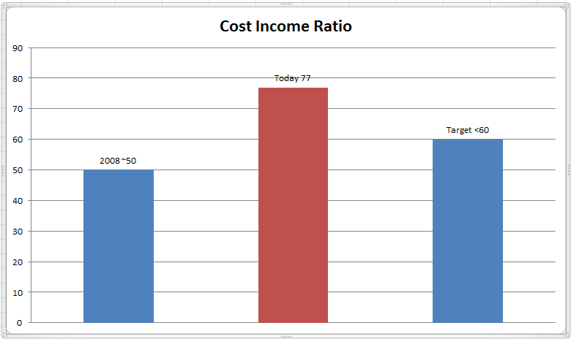
Cost Income Ratio

Slide 28
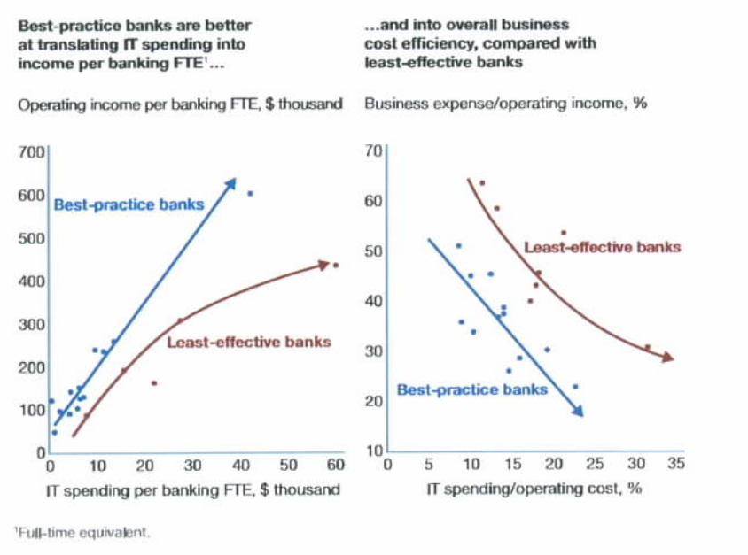
Health & Efficiency

Slide 29
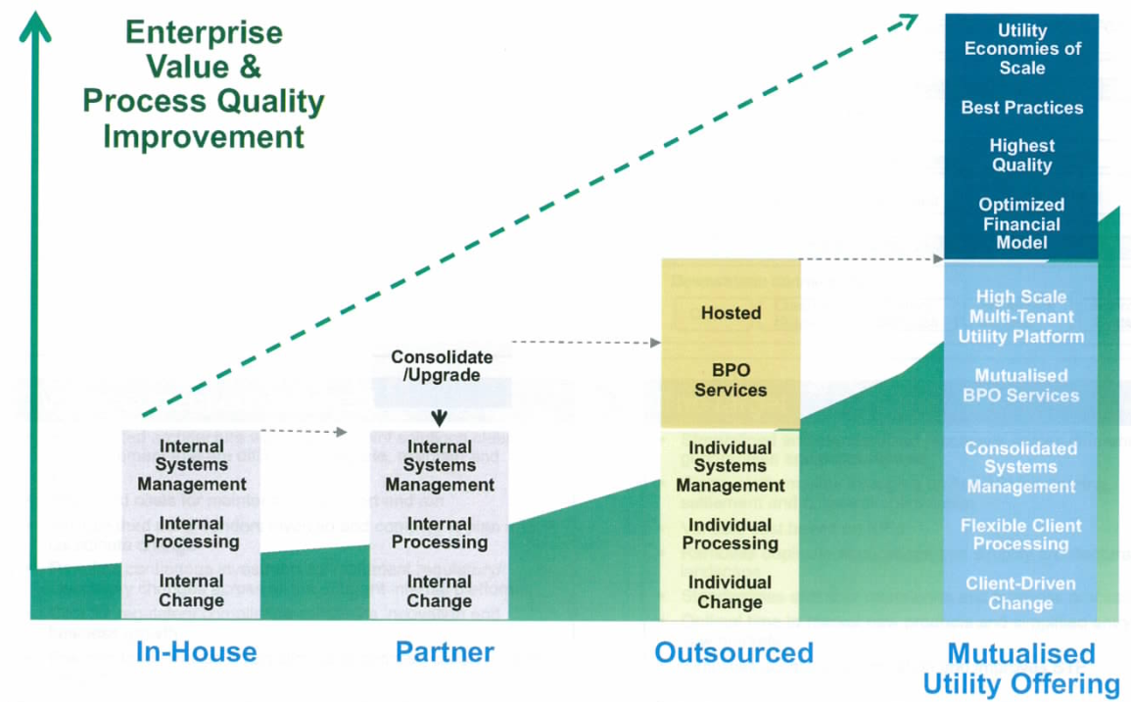
Progression to Utility

Slide 30
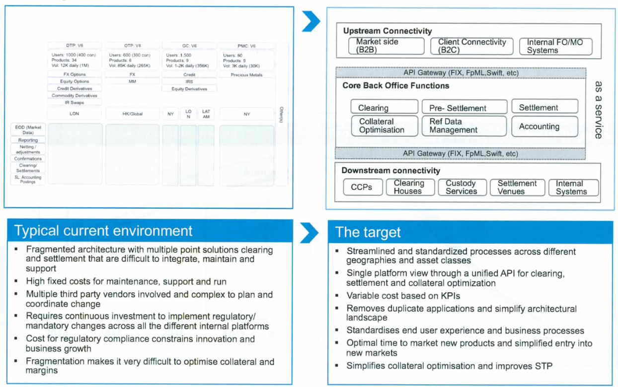
Typical Operating Model

Slide 31
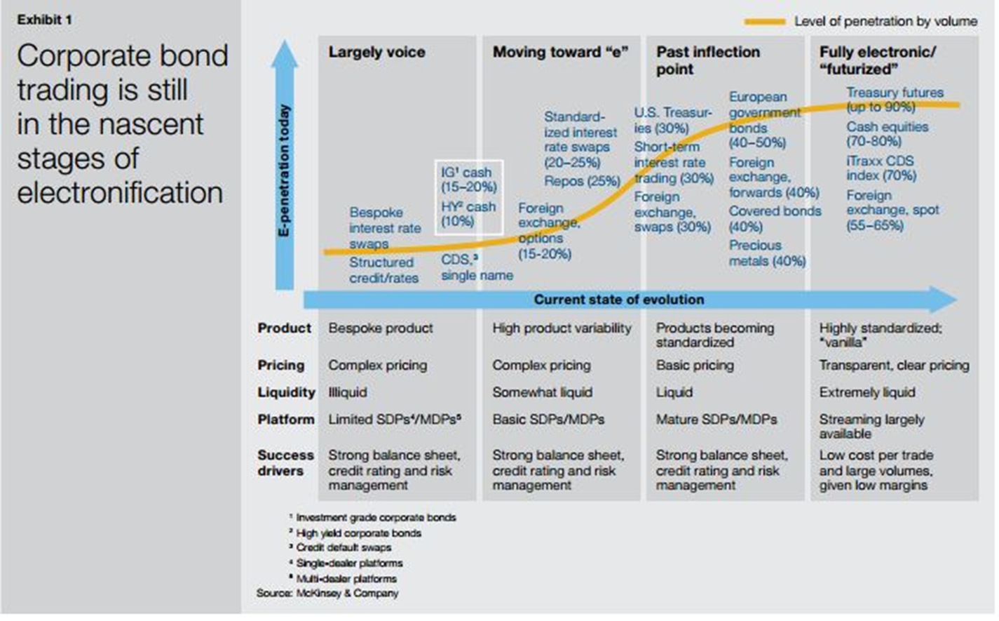
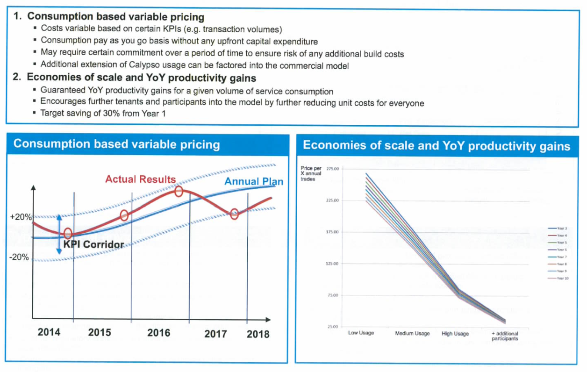
Utility Advantages

Slide 32
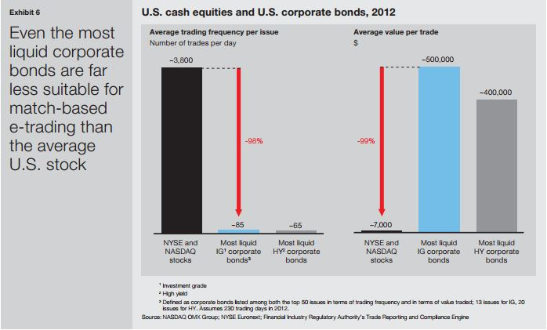
Corporate Bond Trading

Slide 33
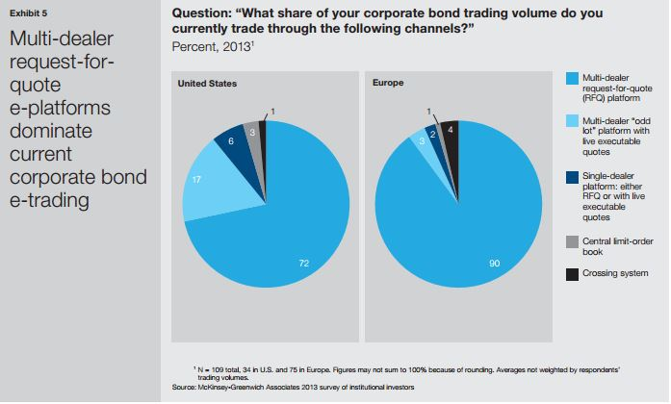
E-trading Corporate Bonds

Slide 34
Adapt. Grow. Thrive.
Andrew Howat
Calypso Technology
FELABAN

Slide 35
Appendix

