Slide 1
Big Data Adoption Drivers
Not Available
Not Available
1
Sources: US Data: IDC 2012 Vertical IT & Communications Survey. N = 4177 LatAm Data: PRELIMINARY RESULTS from IDC Latin America Big Data Survey, June 2013, N = 75

Slide 2
In Banks, Risk Aversion Fuels Big Data
Source: Latin America Finance IT Spending Trends, Mar 2013
N = 35 Large banks in Latin America

Slide 3
Smart Technologies Drive Big Data in Commerce
Source: Latin America Retail IT Spending Trends, Mar 2013
N = 95 Large retailers

Slide 4
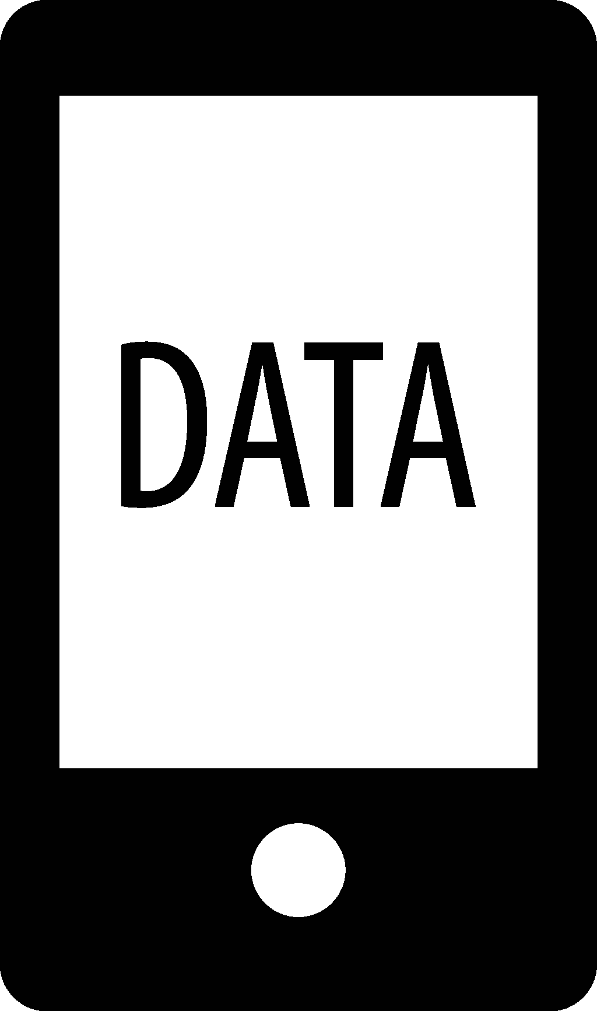
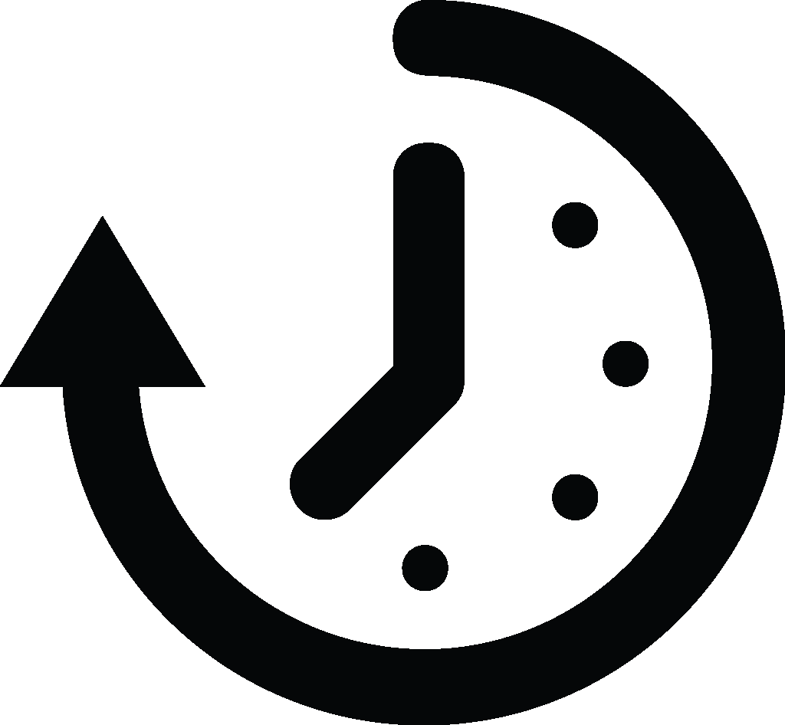
BIG DATA ECOSYSTEM : FROM DATA TO DECISIONS
DATA CREATION
DATA ORGANIZATION
INFO PROCESSING
BUSINESS PROCESS
PRODUCERS
ARCHITECTS / ENGINEERS
ANALYSTS / SCIENTISTS
END USERS
20%
MID-LARGE COMPANIES ANALYZING SOCIAL CHATTER, VIDEO, SENSOR DATA
1 of 3
CREATE MORE THAN 2 NON-TRANSACTIONAL DATA TYPES
2 of 5
HAVE NEVER HEARD OF HADOOP OR MAPREDUCE
1 in 4
NEVER HEARD OF INTEGRATED APPLIANCES, IN-MEMORY, OR NON-RELATIONAL DB
23%
WILL INVEST IN HIGH- SPEED RESILIENT NETWORKS THIS YEAR
5%
HEAVY USERS OF JOINT STRUCTURED/
UNSTRUCTURED DATA ANALYSIS
20%
WILL START USING ADVANCED FORECASTING & AUTOMATIC WEB, EXPLORATION THIS YEAR
20%
WILL INVEST IN ANALYTICS IN THE CLOUD IN 2013-14
Shared Nothing
Scale-out Storage + SSD
Data Exploration
Access-Anywhere Analytics Services
Machine and Sensors
ON-DEMAND
Converged
Infrastructure
Contextualized Data
Context-Aware Business Applications
Geolocation
DEEP INSIGHTS
2 in 3
WILL USE ADVANCED DATA VISUALIZATION IN 2014
Transaction and
Usage Logs
MPP + In-Memory
Compute
Modeling / Scenarios
VOLUME VELOCITY VARIETY VALUE
Location-Based
Services
Hi-Speed / -Resiliency
Networking
Forecasting
PUSH
Mobile Apps Data
8%
HEAVY USERS OF REAL-TIME STREAM PROCESSING
Alert and Respond
Non-relational
DWH
23%
ARE HEAVY TABLET USERS
ALL USE OR PLAN USAGE OF BIG DATA
Email and Messaging
Stream Processing
Workflow and Interaction Automation
Hadoop
REAL-TIME EVENTS
Relationships and Social Influence
EMBEDDED
Cloud
Event Management
Smart devices
and systems
SYSTEMS INTEGRATION
OBJECTIVES
DELIVERY MODELS
Notes:
10 minutes: How we see the Big Data market
The term Big Data has been used by so many people, to include a huge number of things. As a market, we still haven't fully settled in on exactly how to measure Big Data. Maybe the more important thing to see is that there is a growing need to amass as much data as possible, and analyze it in reasonable time on affordable systems. This isn't about a trend, and definitely not hype. IDC research shows that organizations that make decisions based on insights from analytics are more than twice as likely to outperform their peers. Organizations can't ignore that. With the increasing adoption of analytics in decision making, what more does Big Data offer?
We can look briefly at how Big Data is changing our current ways of collecting and analyzing data, then making decisions. Let's look at a simple ecosystem, from how data is created, to how it is captured and prepared, to how it is analyzed, to how it is consumed by end users.
- Data creation
- Data acquisition
- Information processing
- Business process

Slide 5
Essential Guidance
Big Data will be a $380 M market in 2013, but it will surpass a billion dollars in 2015
An attached demand for traditional IT could be between 2X and 3X the value
Successful vendors will integrate solutions and target purchase influencers (CMO, then CFO, COO, CEO)
Industry-specific local examples will be critical to spreading the word
As awareness gives way to consideration, early positioning will drive long-term share capture

Slide 6
Contact
Alejandro Floreán Rodríguez
Vice President Consulting & Strategic Solutions
IDC Latin America
aflorean@idc.com
Twitter: @AlexFlorean
305-351-3141

Slide 7
Big Data Adoption in Latin America Alejandro Floreán Rodríguez IDC Latin America

